Slide 1

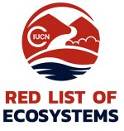

Understanding indicator selection and assessment in terrestrial and alpine Australian ecosystems
Presenting my PhD thesis “Measuring Change in Terrestrial Mountain Ecosystems”
Clare Vernon Deakin University, Melbourne clare.vernon.research@gmail.com

Slide 2
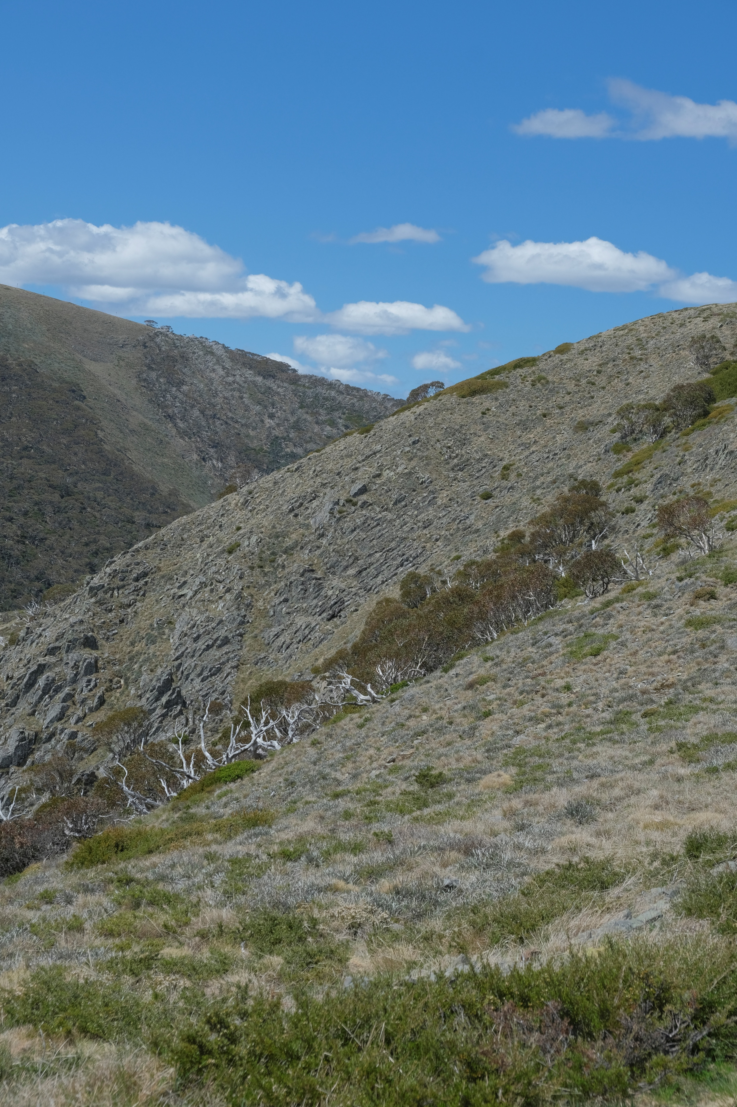
I acknowledge First Nations people and Traditional Owners, both in Australia and globally, as the first scientists who studied ecosystems and documented change, from whose lands data has been collected and presented in this talk today.
Notes:
Before we start, I want to acknowledge first nations people and traditional owners, both in Australia and globally, as the first scientists who studied ecosystems and documented change, from whose lands data has been collected and presented in this talk today.

Slide 3
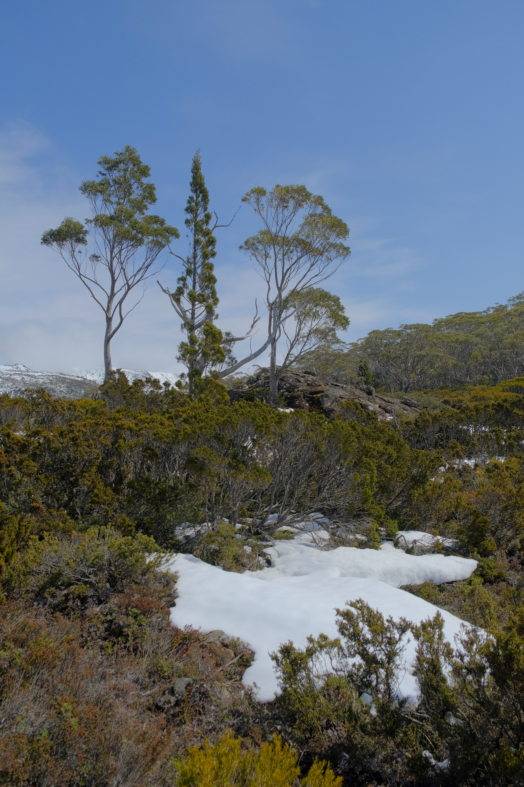
Talk structure
‘The background’
Indicators
IUCN Red List of Ecosystems (RLE)
Thesis research, chapter by chapter
Indicator use in RLE
Alpine RLE assessments
Meta-analysis of shrubs in alpine Australia
Overall findings in the thesis
Notes:
Today, I’ll be presenting my PhD thesis titled “Measuring Change in Terrestrial Mountain Ecosystems”. I’m attempting to summarise four years of work into a single presentation, so by necessity, this will be a fairly high level ‘overview’ talk. I won’t be going into too much detail during this presentation, but please come find me after the session and we can chat more in depth.

Slide 4
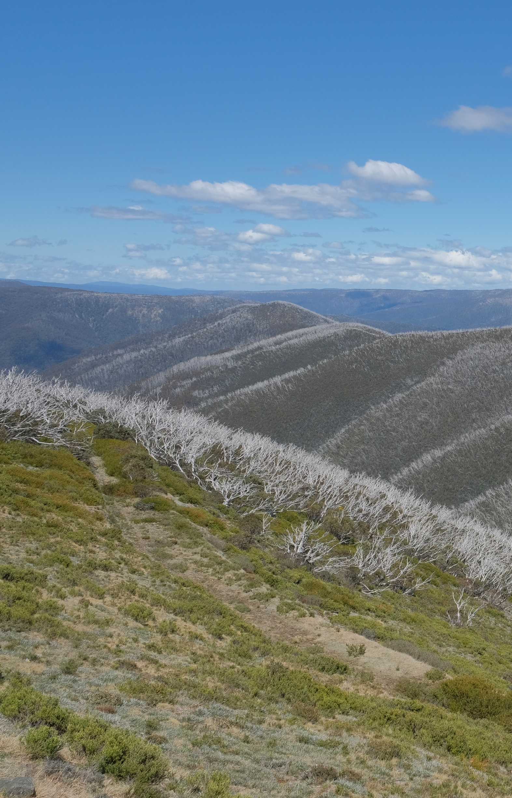
Ecosystems are in decline
Human activities are driving direct (e.g., deforestation) and indirect (e.g., economic trade) declines in biodiversity
Urgent need to identify the integrity of an ecosystem for monitoring, management, intervention, decision making
Notes:
So, we know that human activities are driving extensive, profound and now irreversible changes in biodiversity. Ecosystems in particular are experiencing rapid change, and many of them are undergoing collapse. If we are to address this biodiversity crisis – even if ‘addressing’ means ‘managed collapse’ – then we need some idea of a baseline from which ecosystem integrity, or the health of an ecosystem, can be compared.

Slide 5

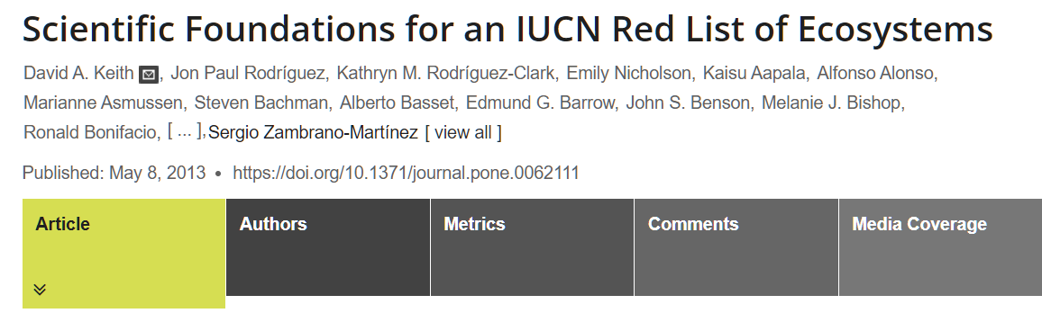
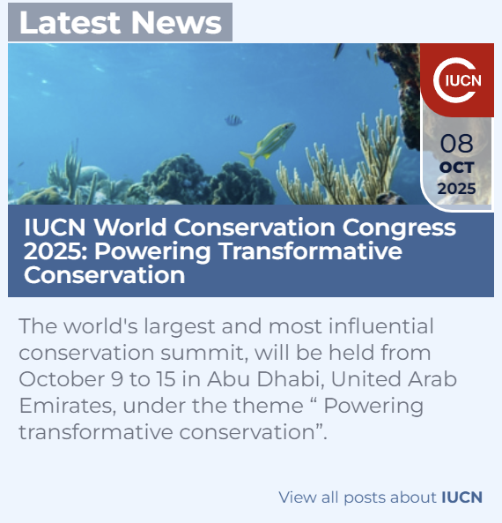

The database of published assessments https://assessments.iucnrle.org/
Notes:
Numerous protocols have been developed to track and assess the condition of biodiversity. Frameworks such as the IUCN Red List of Ecosystems – or RLE - assesses an ecosystems proximity to collapse. If an ecosystem is defined by its characteristic biota, then collapse occurs when that biota are lost. The protocol is now the global standard for assessing collapse, and complements other frameworks in ecosystem accounting, ecosystem goods and services as well as legislation, human development and aid. The RLE has seen enormous uptake globally in the last decade, and more than 4000 ecosystems have now been assessed.

Slide 6
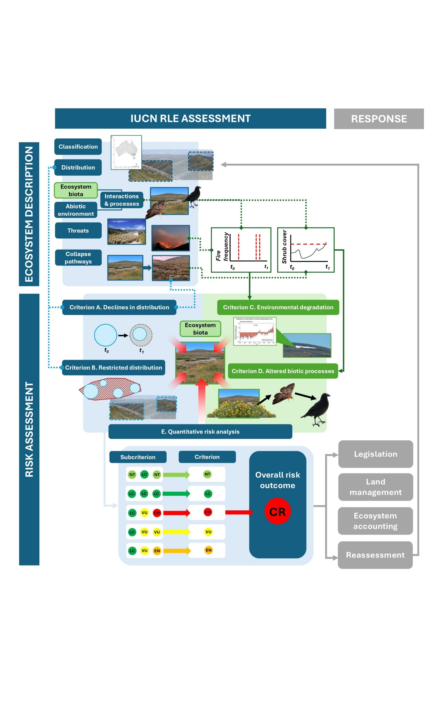
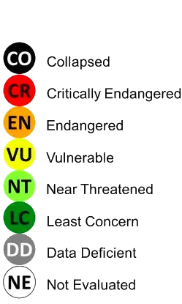
Notes:
The framework assesses an ecosystems risk of collapse using five assessment criteria: changes in an ecosystem's distribution (POINT), changes to its abiotic, nonliving environment (POINT), changes to the characteristic biota that define the ecosystem itself (POINT). It also allows for ecosystem models to be incorporated into the risk assessment process (POINT). These changes are measured through time relative to the present day, and correlate with a risk outcome – on the right.

Slide 7
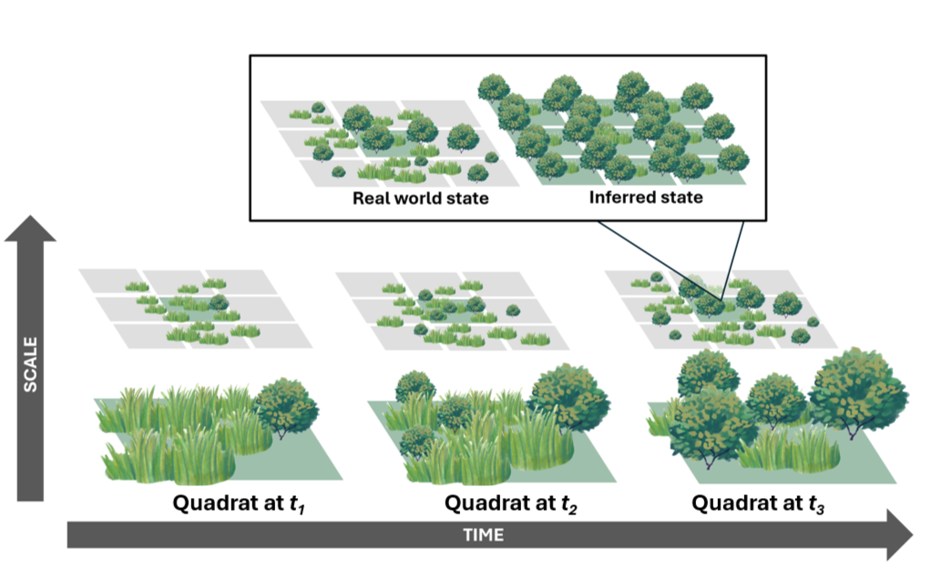
Background: Indicators
Notes:
The framework often relies on indicators to assess Criterions C and D. Indicators are surrogate measures of an ecosystem and communicate the condition of the entire ecosystem. For example: we might use shrub cover to work out whether a grassland is transitioning into a heathland.
However, if our indicator data is patchy or unrepresentative, we may over or underestimate the true risk of collapse. We may also lack strong evidence to determine these collapse thresholds, themselves often arbitrary ‘best estimates’ from the little data that we have on hand.

Slide 8
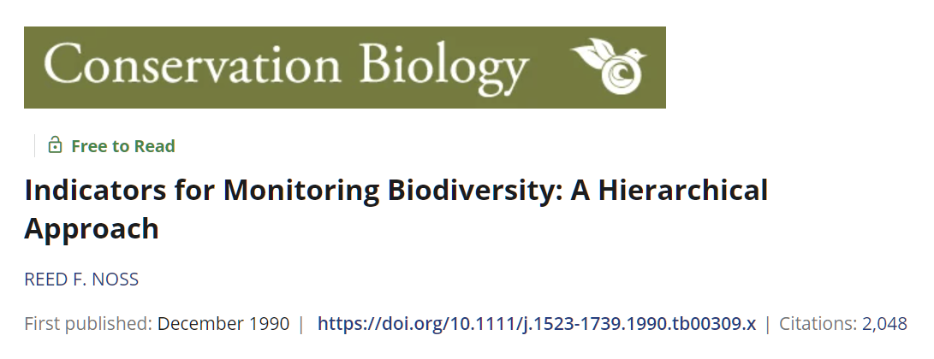

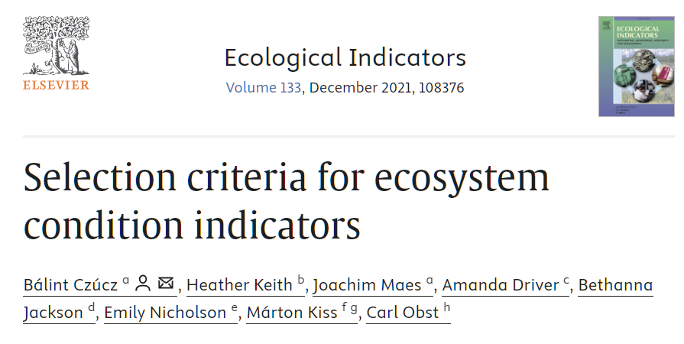
1. What indicators are we using for Red List of Ecosystem (RLE) assessments?
Notes:
For my first chapter, I wanted to find out how assessors are using indicators in RLE assessments. We have enormous bodies of literature testing, identifying and classifying indicators and I wondered whether this “academic” diversity was consistent with “real world” indicator use.

Slide 9
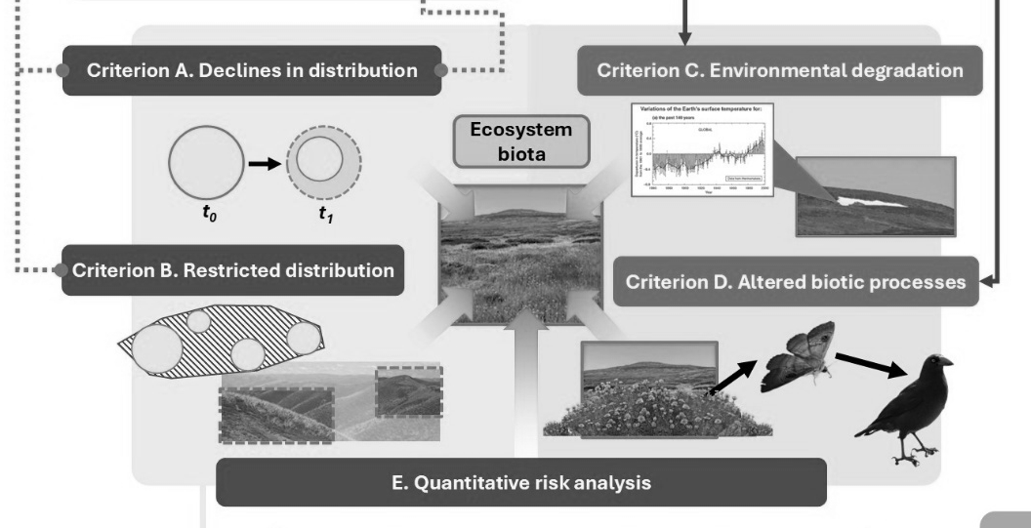
Notes:
Using 1300 published risk assessments of terrestrial ecosystems from around the world, I recorded what indicators are being used to assess the risk of collapse under Criteria C and Criteria D.

Slide 10
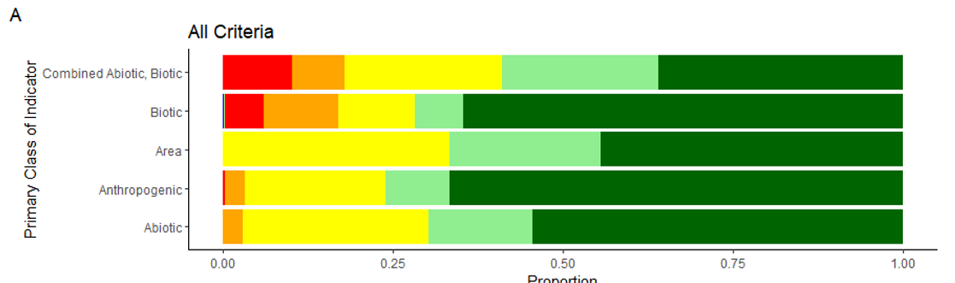
Just over half of all risk assessments assess abiotic (Criterion C) and biotic (Criterion D) decline criteria.
Biotic indicators more often report a higher risk outcome.
Indicator type
Proportion
Notes:
I found that just over half of terrestrial assessments have assessed declines under these criteria. It appears to be more efficient – and perhaps easier - to assess coarse spatial datasets – under Criteria A and B - or construct complex models of several ecosystems simultaneously – Criterion E - than it is to use an indicator to assess ecosystem collapse.
When we do use indicators, biotic indicators – so things like biotic structure, composition and function - are used more often and report a higher risk outcome that other types of indicator. These indicators may capture exclusively biotic processes or combine both biotic and abiotic processes into a single index or metric.

Slide 11
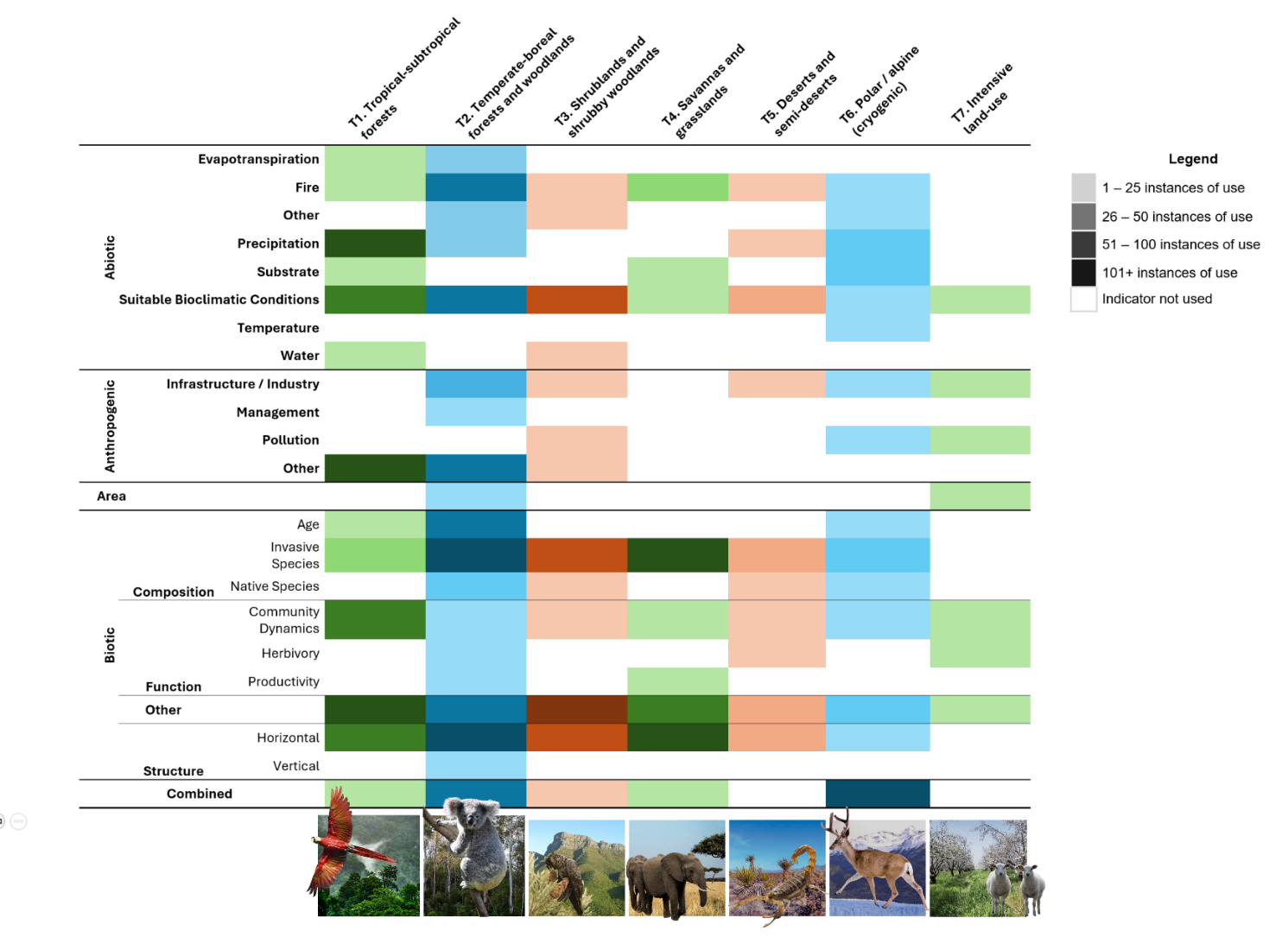
T6 Alpine ecosystems
Precipitation
Substrate
> 150 instances of use (~ 25% of all indicators)
Notes:
Patterns also emerge between the indicator use and ecosystem type. Indicators often reflected the global threats facing that particular type of ecosystem. For example, alpine ecosystems are particularly vulnerable to the effects of climate change, and we see that reflected in indicators of precipitation (such as snowfall) and ecosystem substrates (such as permafrost melt). However, I wasn’t doing this review in isolation…

Slide 12
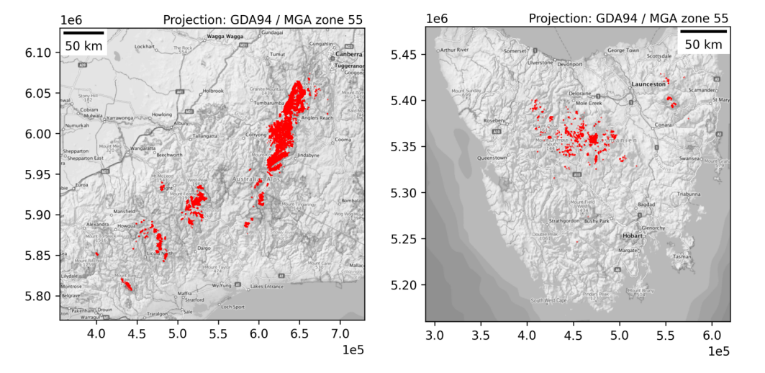
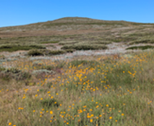
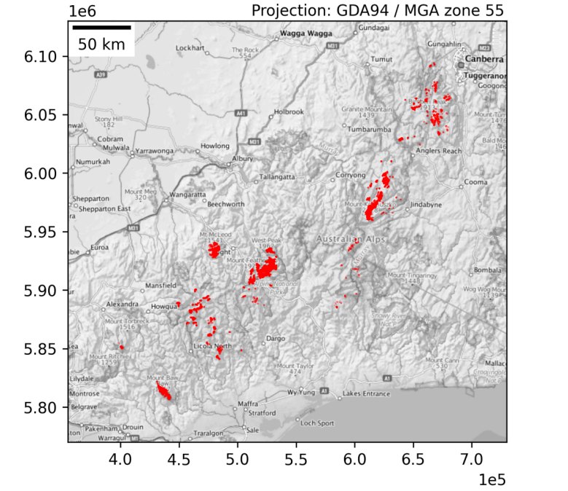
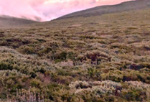
2. RLE assessment of two alpine ecosystems
Australian Alpine Open Grassy Heathland and Herbfield
Australian Alpine Closed Heathland
Note: mainland only
Notes:
I was also wrangling indicators to assess two alpine ecosystems. Australian Alpine Open Grassy Heathland and Herbfield – open heathland - is characterised by dominant Poa grasses and herbs, and a few short shrubs like Grevillea. Importantly, open heathland LACKS a connected, continuous shrub canopy. Closed Heathland is characterised by a connected, dense shrub canopy – usually so dense that in old stands, there is little or no vegetation underneath the canopy.

Slide 13

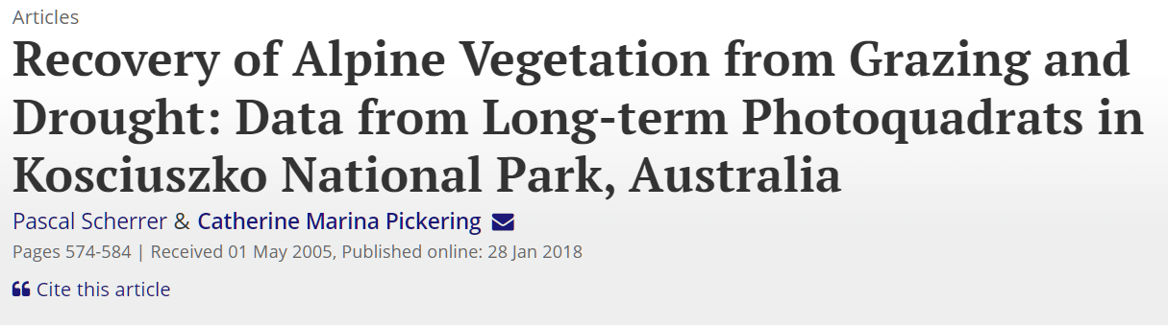
Criteria A – Distributional declines
Distributions have fluctuated through time but unlikely to have collapsed → Least Concern
Liam Mannix in The Age, December 28, 2014
Pascal Scherrer and Catherine Pickering 2002 in Arctic, Antarctic and Alpine Research
Notes:
Risk assessments are quite comprehensive, so I’ll keep the risk outcomes succinct. To assess spatial declines, we used literature and spatial data. We found that the distribution of both ecosystems has fluctuated through time and probably experienced the greatest declines during the late 19th and early 20th century. This was when the alpine region was under the heaviest pressure from grazing and fire. Thankfully, ecosystems appear to be quite resilient. So: declines have occurred but neither ecosystem is likely to have collapsed.

Slide 14
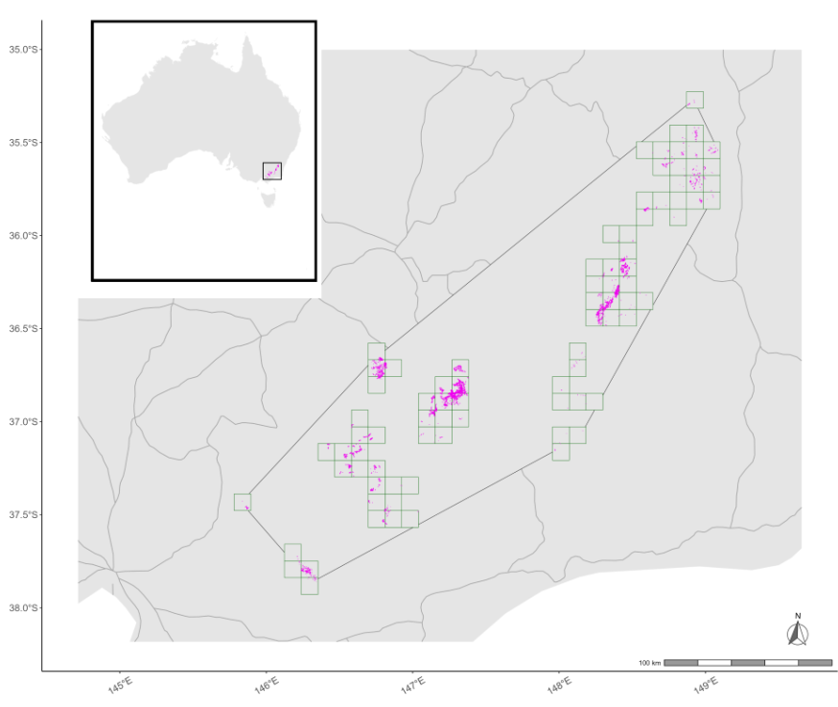
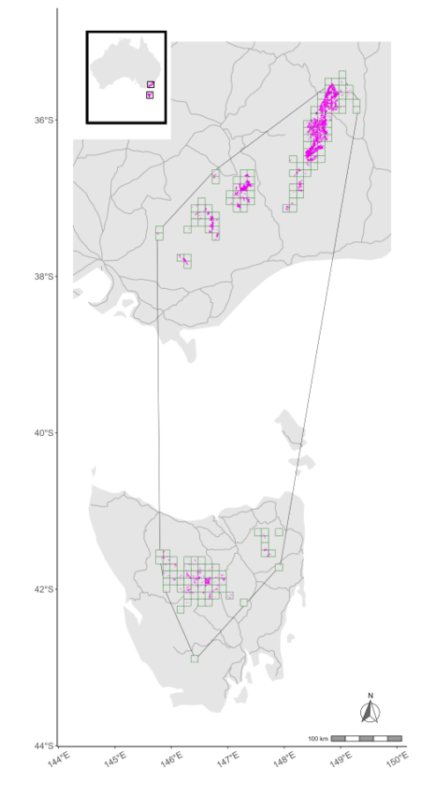
Criteria B – Exposure to widespread threat (e.g., fire)
Both ecosystems have naturally patchy nature → Least Concern
Closed Heathland
Open Grassy Heathland and Herbfield
Notes:
These ecosystems are also quite patchy, so are fairly insulated from a single, widespread event such as fire causing collapse. This was assessed using Area of Occupancy – the grid squares (POINT)– and Extent of Occurrence – the polygon encompassing those squares (POINT).

Slide 15
Criteria C – Environmental degradation
For both ecosystems
Collapse occurs if bare ground doesn’t recover in the expected timeframe→ Least Concern
Collapse also occurs if fire frequency exceeds timeframe for reproductive maturity to be reached (5 – 15 years minimum tolerable interval)→ Least Concern
Notes:
For Criterion C – environmental degradation – I used indicators of fire frequency and bare ground cover. Using future fire models and literature, we found that declines had occurred, but thresholds that would justify a higher, threatened risk outcome were not met during the assessment timeframe.

Slide 16
Criteria D – Biotic decline
Australian Alpine Open Grassy Heathland and Herbfield
Collapse occurs if closed shrub canopy forms
Indicator: shrub cover (%) → Least Concern
Australian Alpine Closed Heathland
Collapse occurs if a closed shrub canopy fails to recover following disturbance (timeframe: 15 years)
Indicator: shrub cover (%) → Least Concern
Notes:
Finally, to assess Criterion D, I used the indicator of shrub cover. I used data from field surveys, and found that whilst shrub cover has increased, it is unlikely to meet thresholds that would trigger a threatened outcome.

Slide 17
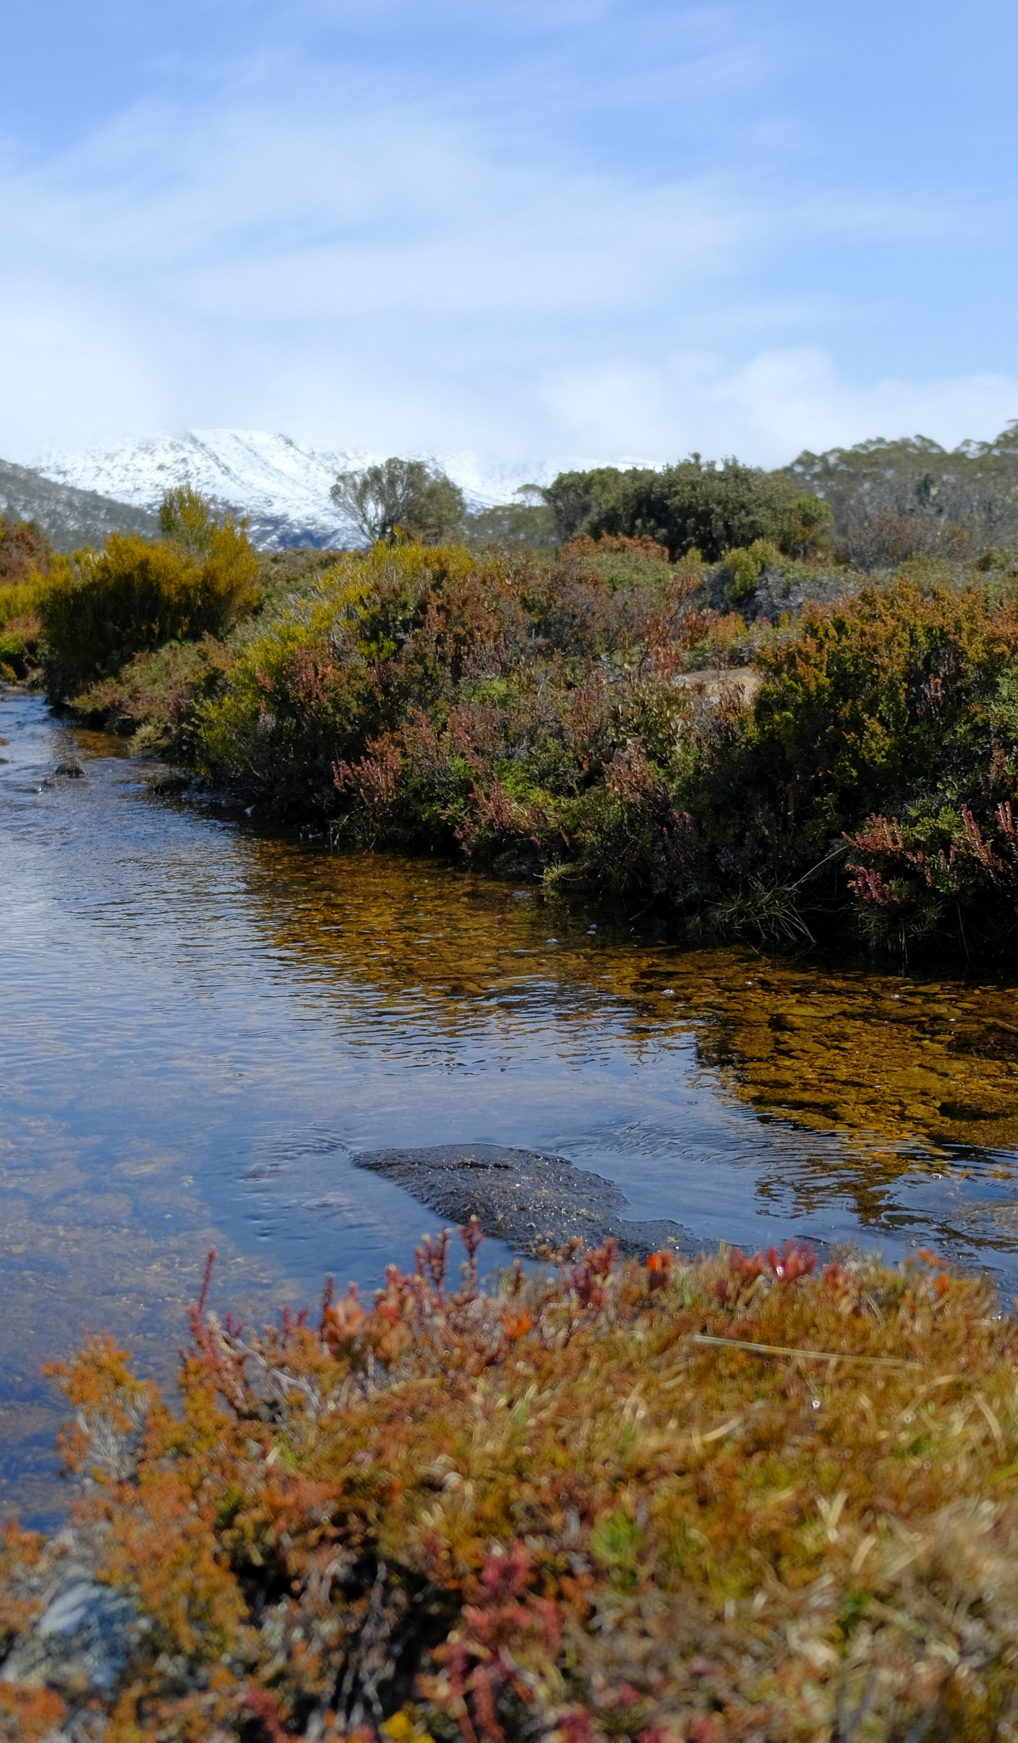
The key player is shrubs
Shrub cover = messy indicator – context and timeframe dependent
Interpretation contingent on how the ecosystem is defined: diffuse boundaries necessary for assessment but not realistic
Indicator can show movement towards collapse (or away from collapse) without triggering a threshold (e.g., shrub cover increasing in OGHH)
Notes:
Shrub cover proved to be a tricky indicator to use in risk assessments. It represented a measure of the biota that characterised both ecosystems. It also represented a threat to Open Heathland, if critical thresholds were exceeded (so if that dense, closed canopy forms). How shrub cover was interpretated depended on how these ecosystems were defined. This itself was uncertain – diffuse boundaries are necessary for assessment but they’re not always realistic… we’re putting human boundaries on things that don’t really exist in neat boxes.

Slide 18
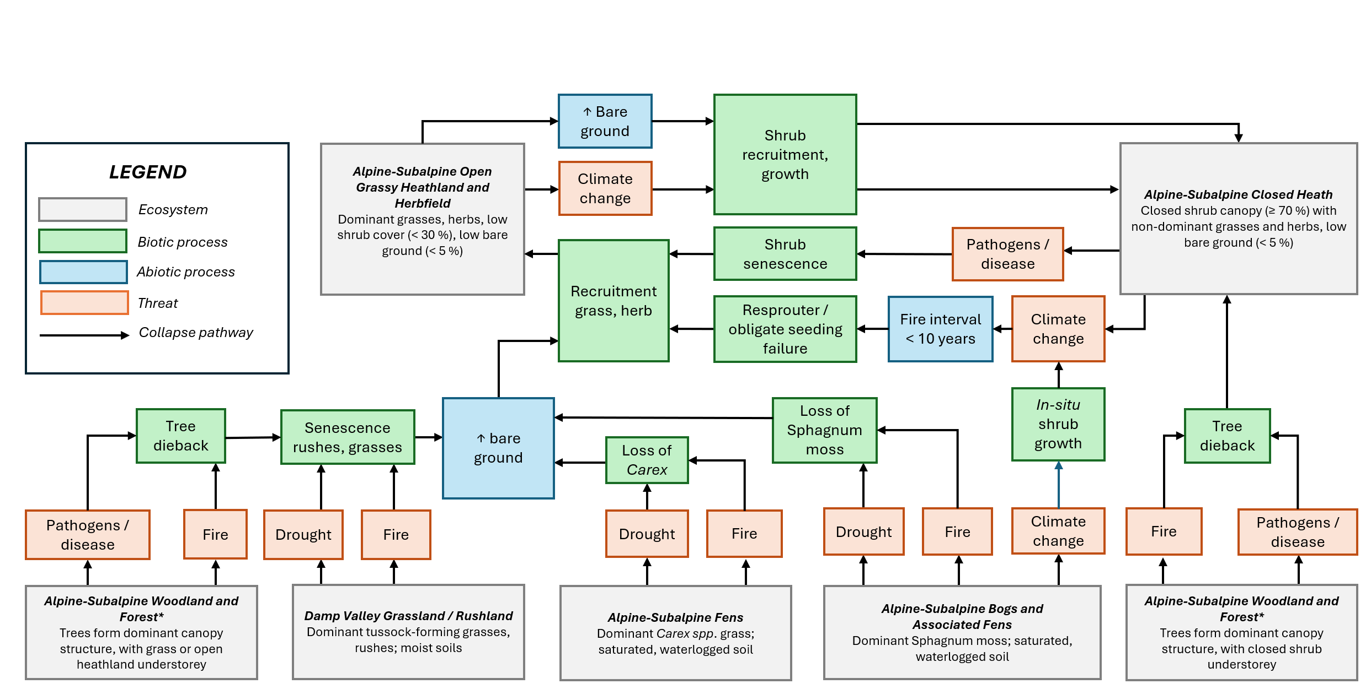
The key player is shrubs
Notes:
Ultimately, the key player is shrubs and the human disturbances such as fire, grazing and climate change. What has been detrimental to other ecosystems – like bogs, fens and snowpatches – has provided opportunities for the heathlands and grasslands to expand. So, if we have grasslands (POINT) with enough recruitment opportunities – fire, bare ground – we eventually get the formation of closed heath. But if those fire intervals become so short that we lose the connected, dense shrub component of the heathlands, then we'll revert to grasslands again.

Slide 19
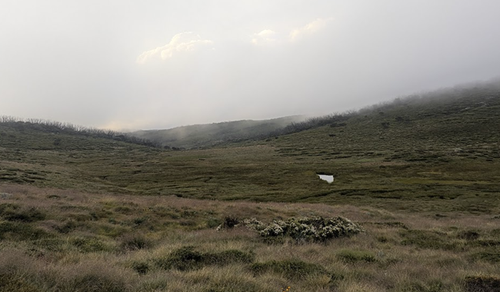
Are shrubs responding consistently to drivers of change throughout alpine Australia?
Notes:
Because shrubs appear to be increasing in Open Heathland, Closed Heathland and other ecosystems such as snowpatches, I wondered whether this pattern was consistent throughout alpine Australia. Are shrubs, regardless of their ecosystem, responding to drivers of change in a consistent way?

Slide 20
3. Meta-analysis of shrub cover change
Population: all field studies of shrub cover change in Australia
Study design: time (BA, BACI), treatment (BACI, CI), time x treatment (BACI)
Outcome: shrub cover (%)
Note: interested in relative change (+/-) not absolute change (%)
Notes:
And this led to the biggest research project of the entire thesis – a meta-analysis. The details of the project are briefly on the screen, but to summarise: I recorded the change in shrub cover following exposure to a driving process from more than 40 field studies across alpine Australia and used these data points to construct multi-level meta-regression models.

Slide 21
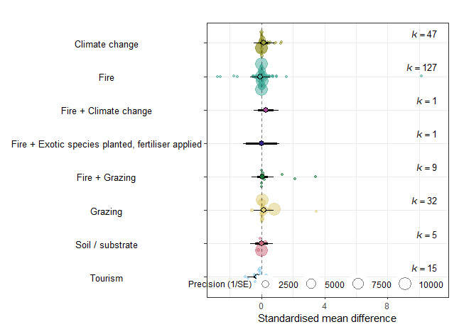
Human activities are not consistently promoting or reducing shrub cover p = 0.92
Only tourism reduces shrub cover (patchy evidence) p < 0.01
Patchy, highly heterogeneous data – masking true, underlying effect?
No effect
Notes:
My meta-analysis found that human activities are not consistently promoting or reducing shrub cover. Climate change (POINT), Fire (POINT), the presence of introduced species (POINT), grazing (POINT) and changes to the substrate, such as erosion (POINT) both promote some shrubs and reduce others. We know this because the 95% confidence interval – this solid black, horizontal line – crosses the dashed line of “no difference” or “no effect”. Only tourism consistently reduces shrub cover (POINT). Keep in mind that there may be a true, underlying effect but we need more data to detect this – meta-analyses are inherently conservative in nature.

Slide 22
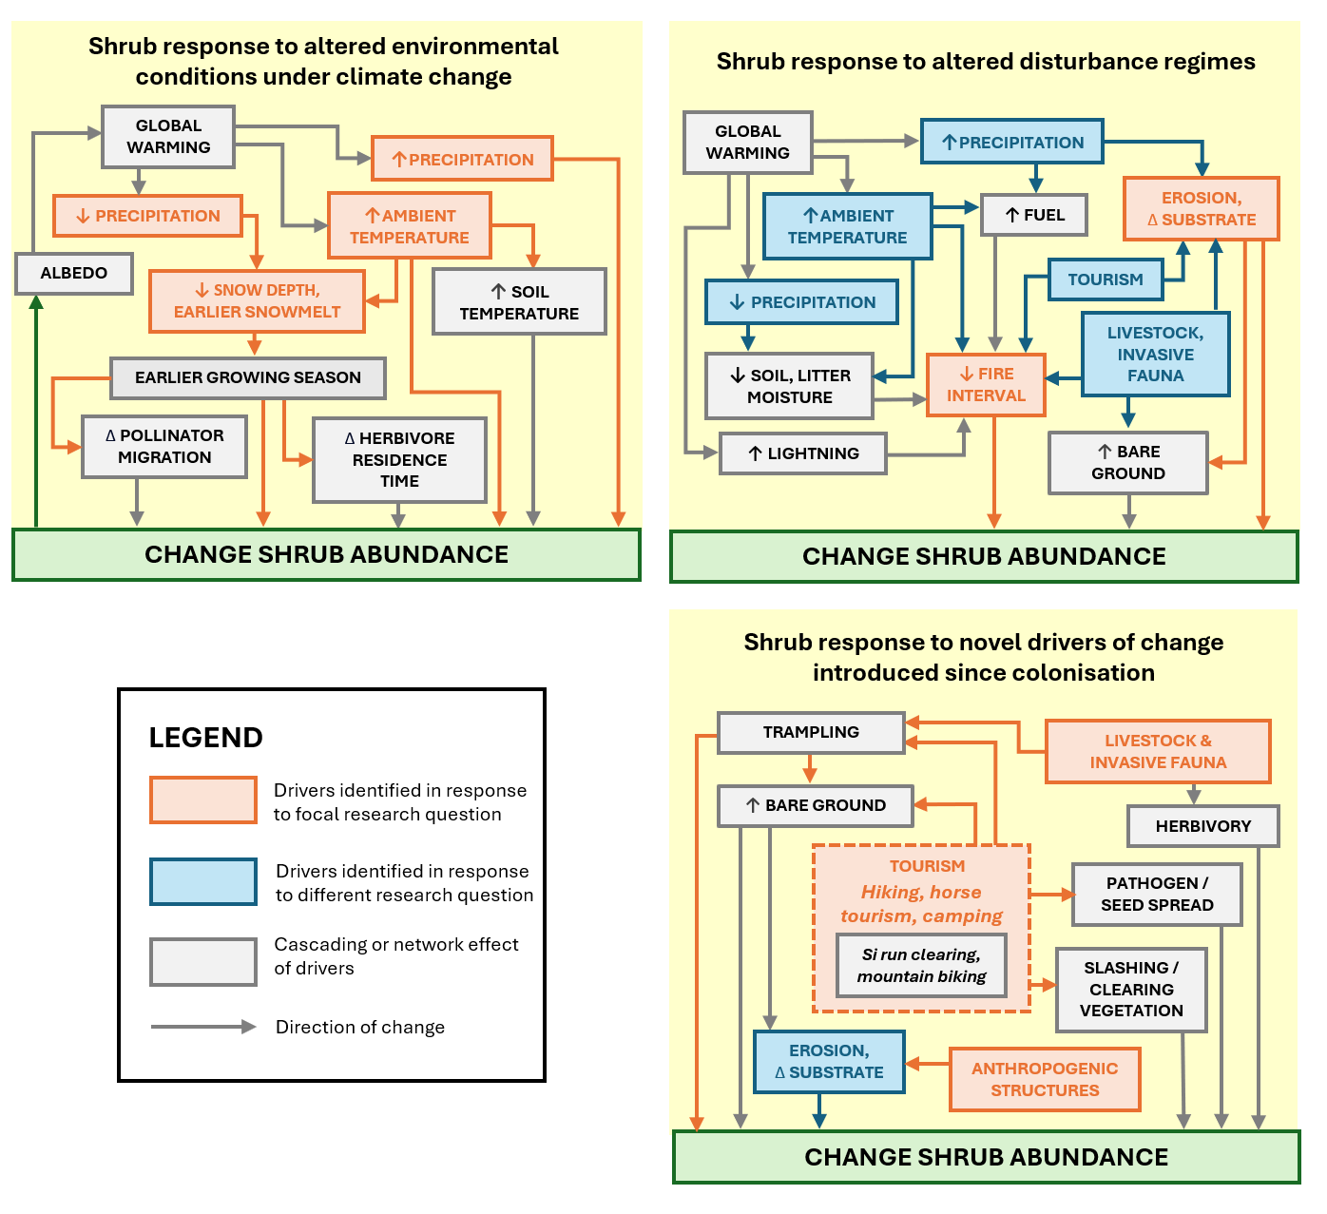
Notes:
When I mapped the qualitative “does it increase or decrease shrubs” – we do see some patterns. We just don’t have enough consistent replicates to demonstrate this quantitatively – yet!

Slide 23
That was a lot.

Slide 24
In a nutshell
One observation or pattern may not represent the true behaviour of an indicator species or organism (Chapter 3)
Risk assessments remain valuable even when challenged by resource constraints or data limitations… (Chapter 1, 2)
…. But we need to be cognisant of the data, and what it does (and does not) tell us and the inferences we make (Chapter 3)
A risk outcome of Least Concern does not mean that declines haven’t occurred, just that they are unlikely to cause collapse (Chapter 1, 2)
Assessments are a pragmatic tool in the decision-making toolkit
Notes:
I feel I should bring it all together now. What did we learn after fours years of hard work?
One observation or pattern may not represent the true behaviour of an indicator species or organism
Risk assessments remain valuable even when challenged by resource constraints or data limitations…
…. But we need to be cognisant of the data, and what it does (and does not) tell us and the inferences we make
A risk outcome of Least Concern does not mean that declines haven’t occurred, just that they are unlikely to cause collapse
Assessments are a pragmatic, not perfect tool on the decision-making toolkit. We need to be aware of what questions they can answer – 50 years in the future – and this may not capture the slow timeframes of recovery of the ecosystem of interest.

Slide 25

I’ve submitted my PhD thesis and I’m now looking for the next step in my career!
LinkedIn →
clare.vernon.research@gmail.com
cmvernon@deakin.edu.au
Thank you to my supervisors (Susanna Venn, Emily Nicholson, Chloe Sato, Jess Rowland), colleagues, collaborators and kind donators of data
Notes:
Of course, a PhD thesis – and indeed, any research project – is a team effort and I need to acknowledge my supervisors, collaborators and co-workers. I’m still waiting to hear back from the examiners, but please reach out to me on LinkedIn or using the email addresses above if you’d like to know more. Thank you for you time!

